Slide 1

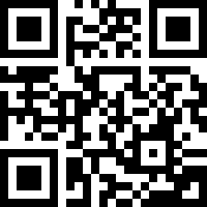
HOUSE BILL 247: Underground Utility Safety and Damage Prevention Act Revisions.
2025-2026 General Assembly
Notes:
Welcome, everyone. Today we’re going to walk through the updates introduced by House Bill 247 to the Underground Utility Safety and Damage Prevention Act, effective October 1.
You’ll find a QR code on your screen that links directly to the law page on nc811.org. There, you’ll see:
The current law, valid through September.
The updated law, effective October 1, 2025
There is reference guide comparing the old and new provisions.
There is also a full-length video of this presentation that you can watch at your leisure.
And if you have any questions about any part of the law you can fill out the Law FAQ form and one of our liaisons will provide you with clarification on any of your concerns.

Slide 2

OVERVIEW: House Bill 247 would do all of the following with regard to marking of underground utilities:
Specify that nonmechanized equipment includes soft dig technologies.
Clarify the standards of painted surface marks for operators marking underground facilities and adjust response times for requests for marking of a facility.
Shorten the notice period for projects not involving subaqueous facilities, extend notice validity, limit the area for facility location requests, and clarify excavation practices near pipelines.
Amend exemptions from requirements for notice before commencing an excavation.
Clarify that the venue for all actions arising from actual and consequential damages occurring in this State is the county where the damages occurred.
Create a rebuttable presumption that an excavator has exercised due care in certain circumstances.
Make changes to the Underground Damage Prevention Review Board (Board) concerning vacancies and quorum and allow an informal conference process to request that the Board reverse or modify its determinations concerning violations of the Act.
Notes:
Let’s begin with an overview of the key changes. We’ll cover:
Definitions
Facility operator responsibilities
Excavator responsibilities
Exemptions
Damage Claims
Facility location absence
Updates to the Underground Damage Prevention Review Board

Slide 3
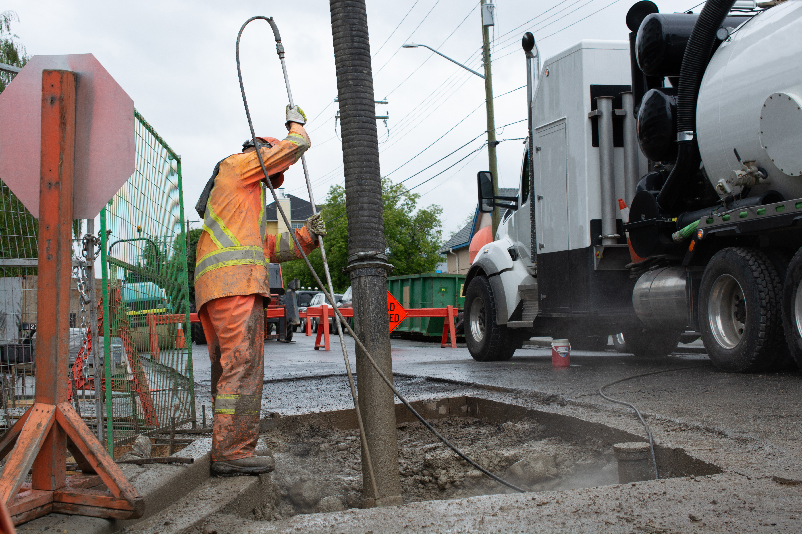
Section 1 – (87-117) Definitions
§ 87-117 (15) – Nonmechanized equipment – Hand tools and soft dig technologies.
§ 87-117 (20a) - "Soft dig technologies"- An excavation method that uses air or water pressure to break up soil and remove it with vacuum extraction.
§ 87-117 (22) – Tolerance zone – If the diameter of the facility is known, the horizontal distance of one-half of the known diameter plus 24 inches on either side of the designated center line.
Bold Print References Law addition
Notes:
Starting with definitions.
Non-Mechanized Equipment was previously defined as hand tools.
Now, Soft Dig Technologies—which use air or water pressure with vacuum extraction—are also considered non-mechanized.
Next, the Tolerance Zone definition has been clarified. It now explicitly refers to the horizontal distance: half the known diameter of the facility plus 24 inches on either side of the center line.

Slide 4
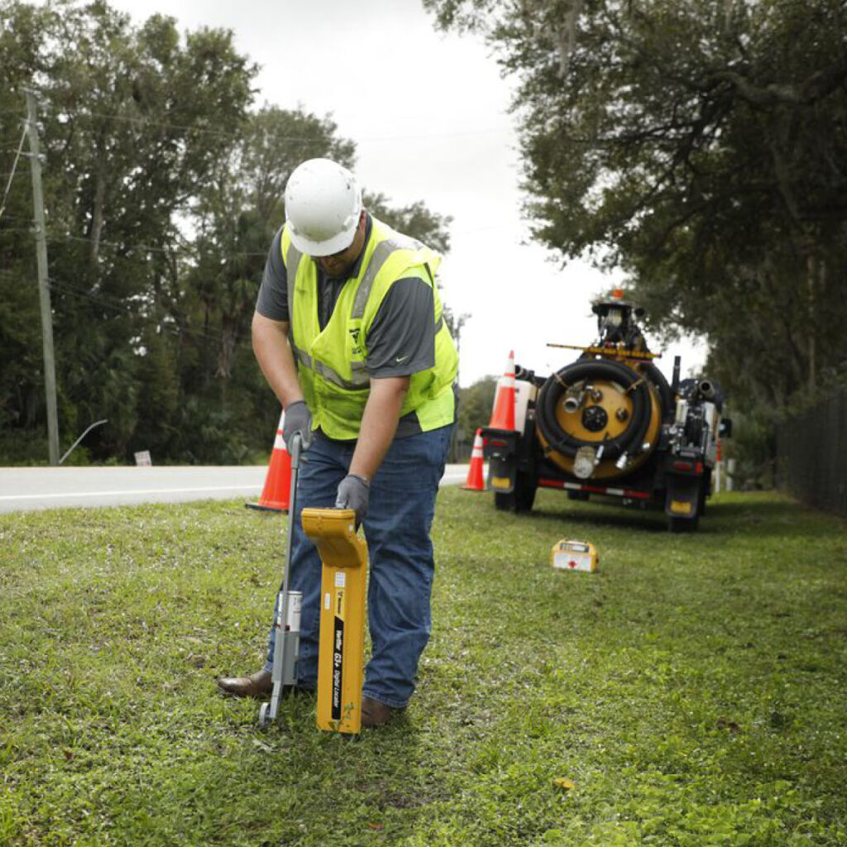
Section 2 – (87-121) Facility operator responsibilities
§ 87-121 (a)(1) The operator shall, when marking as provided under this subdivision, use the APWA Uniform Color Code. Where practical, painted surface marks should be of adequate length to distinguish from dots.
§ 87-121 (b) Unless otherwise provided in a written agreement between the operator and the excavator, including an electronically transmitted written agreement, the operator shall provide to the excavator the information required by subsection (a) of this section within the times provided below:
Bold Print References Law addition
Notes:
Facility operator responsibilities
Operators must use APWA uniform color codes when marking.
A new requirement states that painted marks should be long enough to distinguish them from dots.
Also, written agreements now include electronically transmitted formats—such as email, text, or fax.

Slide 5
Section 2 – (87-121) Facility operator responsibilities
§ 87-121 (b)(1) For a facility, within three full working days prior to the work start date provided by the excavator.
§ 87-121 (b)(4) For an emergency request, an initial contact with the excavator shall be made within 3 hours.
§ 87-121 (b) (5) For a request of an unmarked facility required by GS 87-122 (c)(6) the operator shall arrange for the facility to be marked within three hours from the time the additional notice is received by the Notification Center.
Bold Print References Law addition
Notes:
Operators must mark facilities three full working days before the excavator’s work start date.
For emergency requests, operators must make initial contact within 3 hours.
And if a facility is unmarked, operators must respond within 3 hours of receiving the additional notice.

Slide 6

Section 3 – (87-122) Excavator responsibilities
§ 87-122 (a) Require that notice for any excavation or demolition not involving a subaqueous facility must be given no less than three full working days before the proposed commencement date of the excavation or demolition.
§ 87-122 (a) Require that notice for any excavation or demolition in the vicinity of a subaqueous facility be given no less than 10 to 20 full working days before the proposed commencement date of the excavation or demolition.
Bold Print References Law addition
Notes:
Excavator Responsibilities
Excavators must give notice no less than 3 full working days before starting work. For underwater facilities, the notice period is no less than 10 to 20 working days.

Slide 7
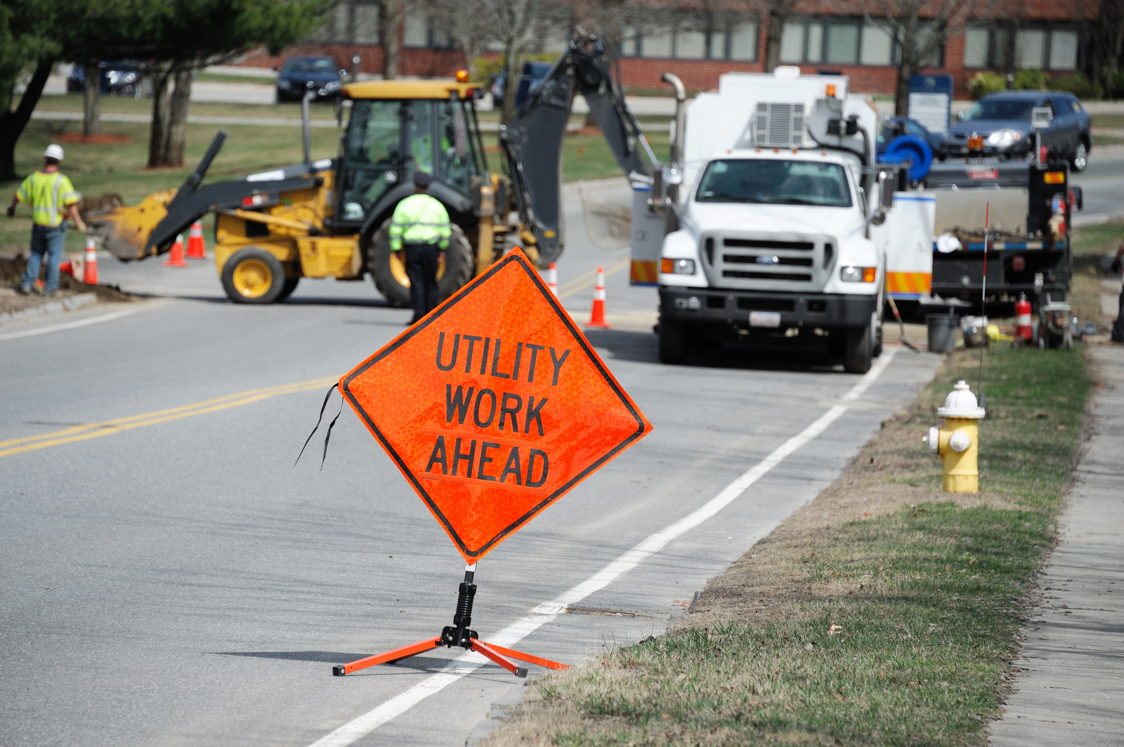
Section 3 – (87-122) Excavator responsibilities
§ 87-122 (a) Notice given pursuant to this subsection shall expire 28 calendar days after the work start date. No excavation or demolition may continue after this 28-day period unless the person responsible for the excavation or demolition provides a subsequent notice which shall be provided in the same manner as the original notice required by this subsection.
§ 87-122 (b)(5) The area of locate of the proposed excavation which is limited to an area that the excavator reasonably believes may be completed within 28 calendar days from the work start date and does not include any areas completed and accepted by the authorities having jurisdiction.
§ 87-122 (c)(10) The excavator shall use nonmechanized equipment within a 24-inch circumference around an oil, petroleum products, or highly volatile liquid pipeline system, a gas transmission line or electric transmission line unless the facility operator has consented to the use in writing and the operator's representative is on site during the use of the mechanized equipment. Within the tolerance zone of a pipeline system, the excavator shall use safe excavation practices, including, but not limited to hand digging or potholing.
Bold Print References Law addition
Notes:
Tickets now expire 28 calendar days after the work start date—up from the previous 15 working days.
Tickets should only cover areas that can reasonably be completed within that 28-day window. Don’t update tickets for areas that are already completed.
When working near transmission pipelines, excavators must use non-mechanized equipment within 24 inches of the pipeline. Also, within the tolerance zone of a pipeline system, the excavator shall use safe excavation practices, including, but not limited to hand digging or potholing.

Slide 8
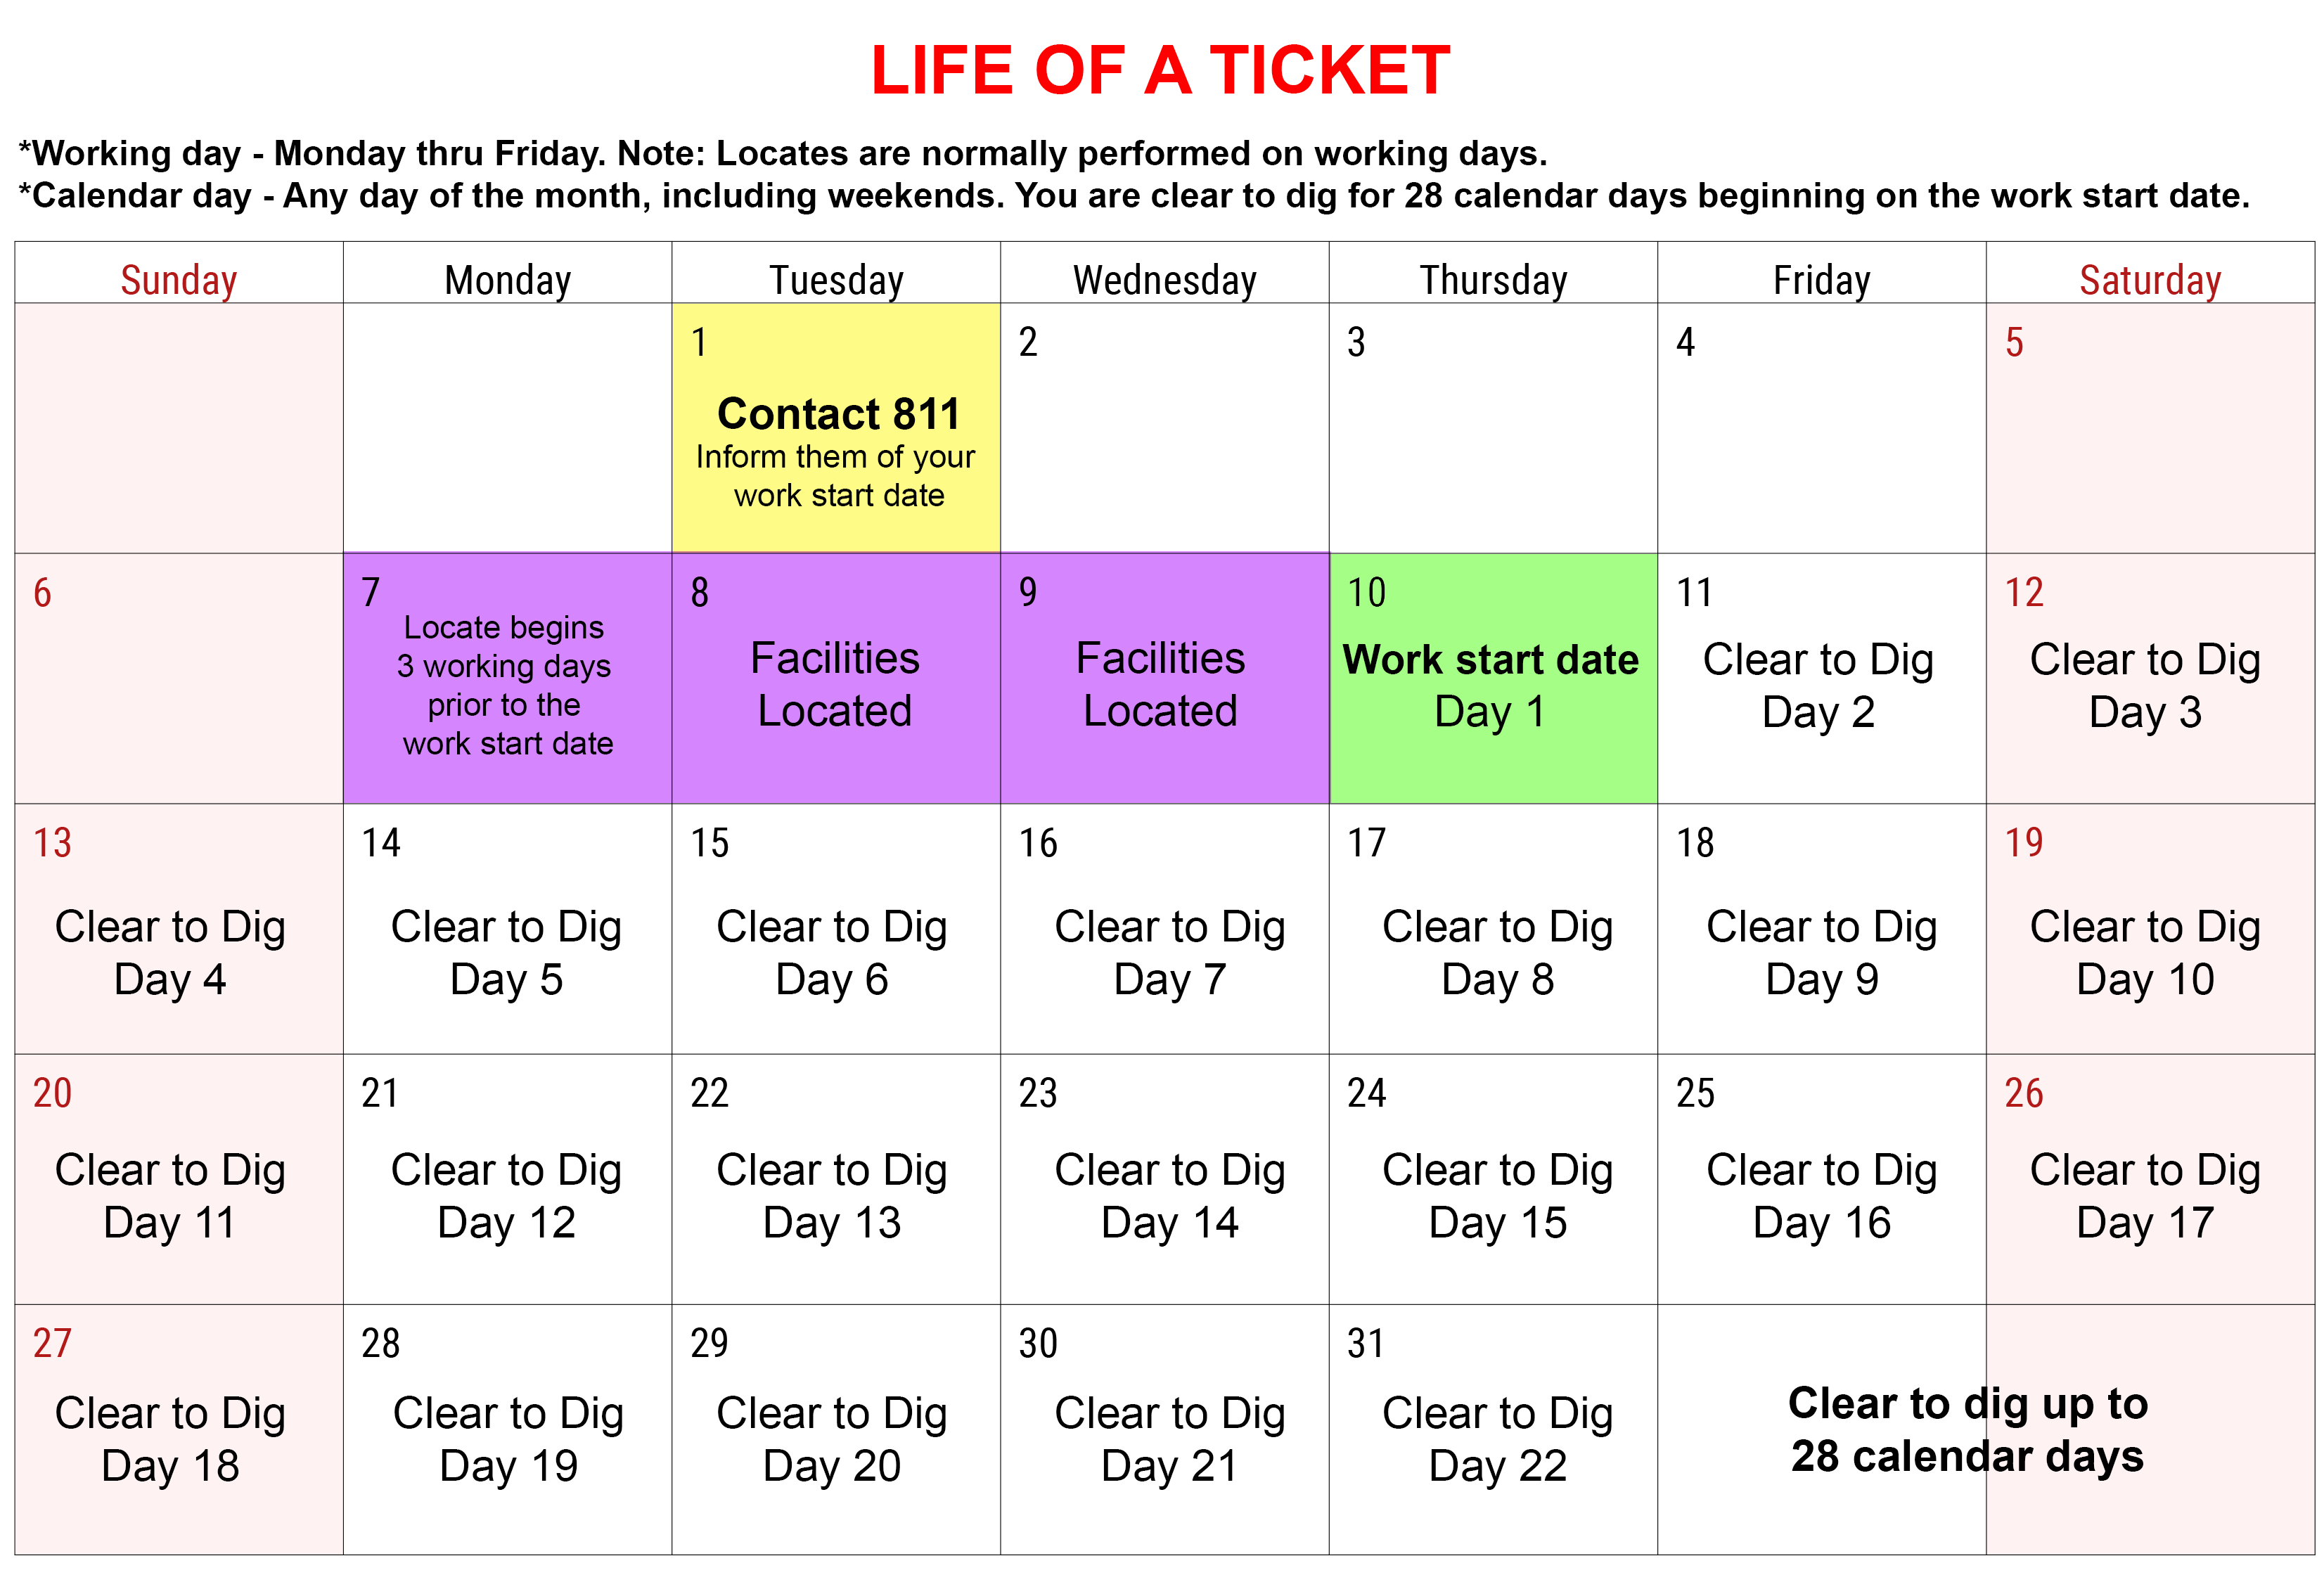
Notes:
Here we see an example of the life of a ticket.
In this example the excavator contacted 811 on the 1st. During the call or while creating the RTE or SAT ticket the work start date is noted on the ticket. Three full working days prior to the work start date, locators will be dispatched to mark your excavation area. The life of the ticket begins on the Work start date and you are clear to dig for up to 28 calendar days.

Slide 9
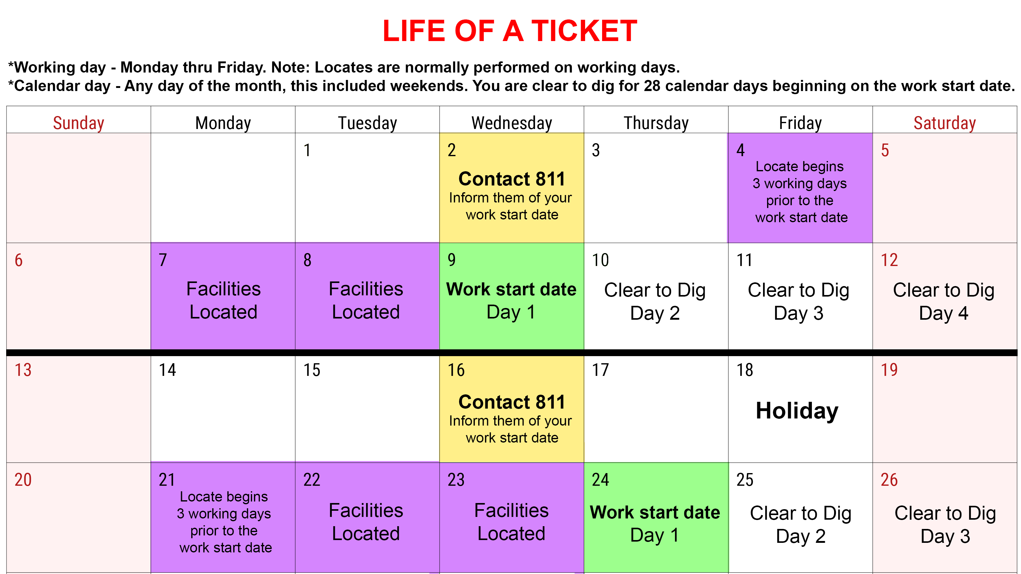
GRAPH 1
GRAPH 2
LIFE OF A TICKET (HOLIDAY)
Notes:
Weekends and Holiday can affect the locate process. Here are some examples.
In graph 1 you see when the locate would be performed if the start date lands on a Wednesday. The locate would begin on Friday and continue thru Tuesday.
In graph 2 you see what would happen if a holiday landed on a Friday during the locate process.

Slide 10
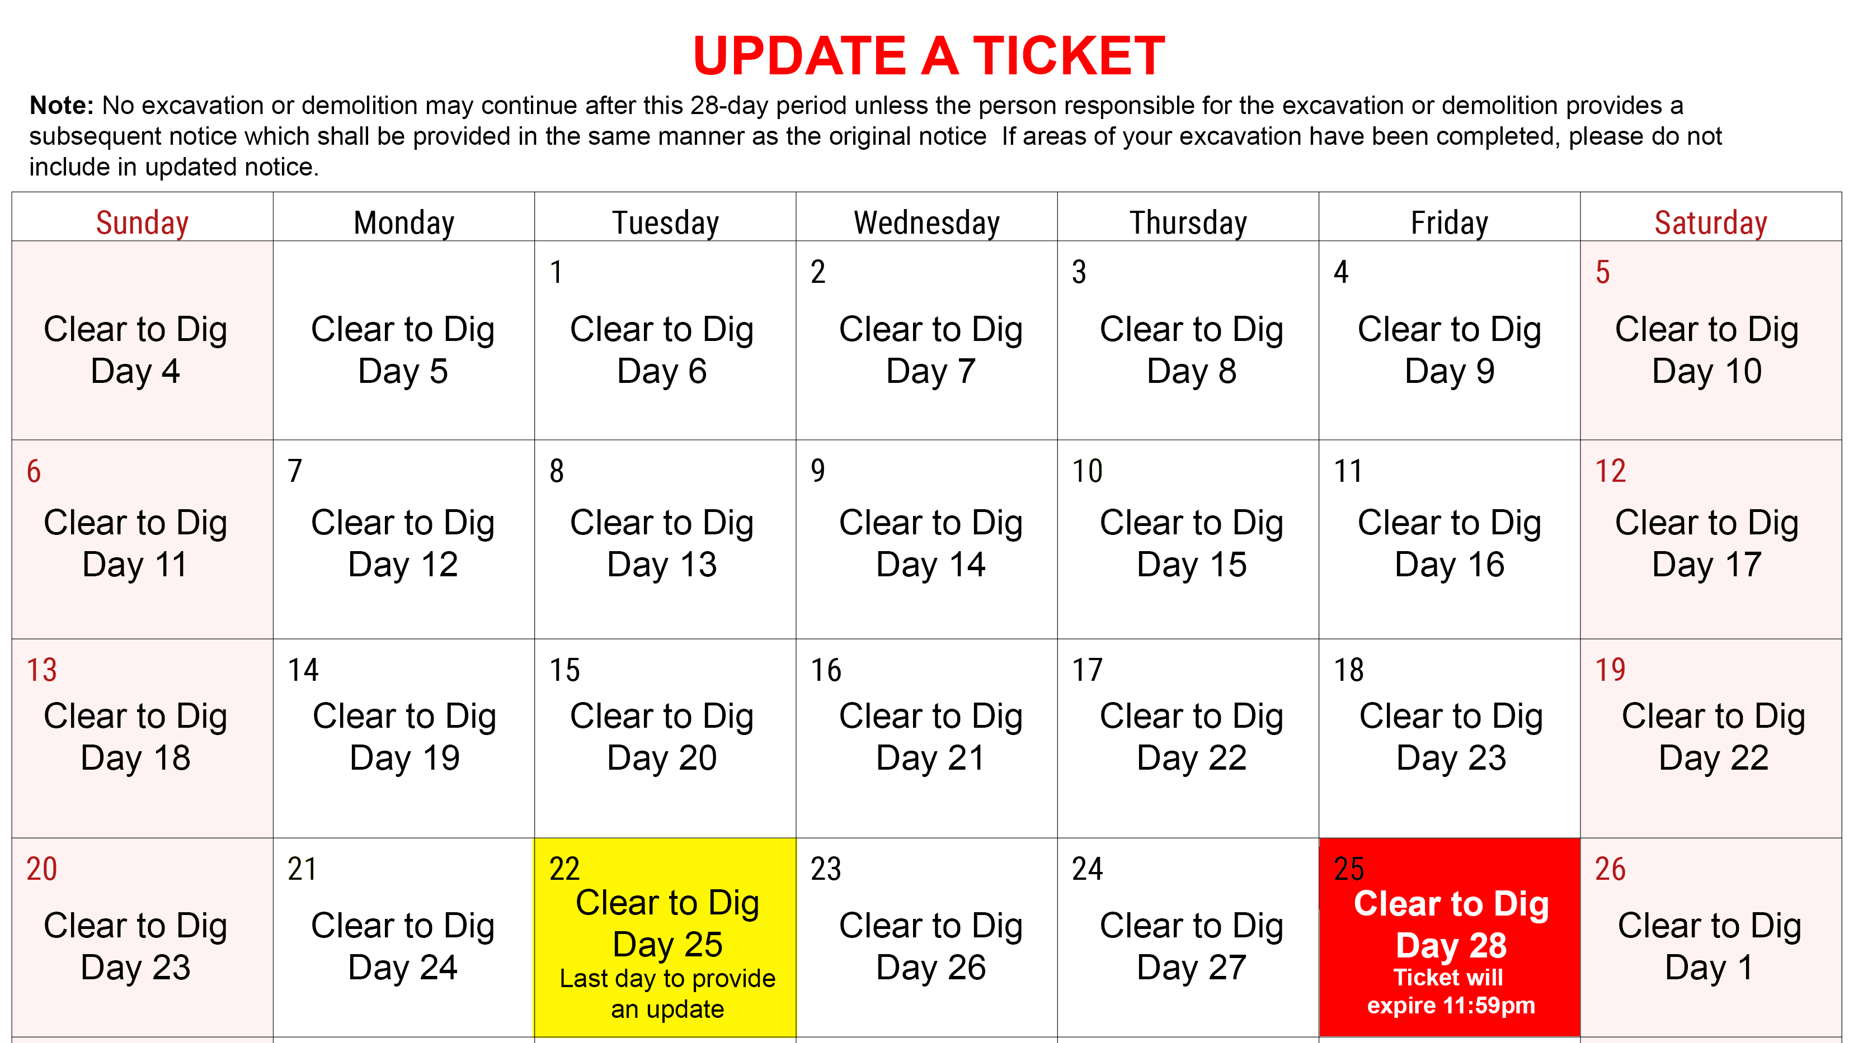
Notes:
In order to extend the life of your ticket past the 28 calendar days you will need to submit a subsequent notice 3 full working days prior to the expiration date of your locate request. In this example you need to provide your updated no later than day 25 of your ticket. Locators then have day 26, 27 and 28 to update the locate request. When you submit your subsequent notice, do not include any areas of your excavation that have already been completed. After 11:59pm on day 28, your ticket will begin again, giving you another 28 calendar days for excavation to take place.

Slide 11
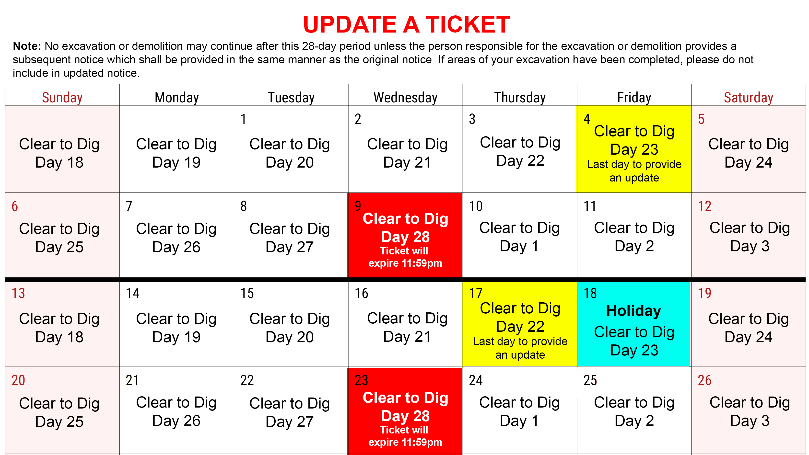
GRAPH 1
GRAPH 2
UPDATE A TICKET (HOLIDAY)
Notes:
Weekends and Holiday can affect the update process too. Here are some examples.
In graph 1 we see that the 28th day of the ticket lands on a Wednesday. Since the update must be made on a working day, the ticket is updated on the 23rd day of the ticket, giving the locators 3 full working days to respond to the update, the 26th, 27th and 28th days of the ticket.
In graph 2 a holiday lands on a Friday so the update must now be made no later than the 22nd day of the ticket.

Slide 12

Important Update: NC811 Ticket Entry System Transition on October 1st
NC811 will be transitioning to a new ticket entry system—Center Logix—effective October 1st, coinciding with changes to the law. This marks our move away from the current Newtin system. Please note that Newtin and Center Logix are entirely separate platforms and do not share data or communicate with one another.
If you submit a ticket in Newtin during the last 15 working days of September and it requires an update after October 1st, you will need to create a new ticket in Center Logix. A reminder of this requirement will be included in the remarks section of your original ticket.
We appreciate your attention to this important change and encourage you to plan accordingly to ensure a smooth transition.
Notes:
Important Update: NC811 Ticket Entry System Transition on October 1st
NC811 will be transitioning to a new ticket entry system—Center Logix—effective October 1st, coinciding with changes to the law. This marks our move away from the current Newtin system. Please note that Newtin and Center Logix are entirely separate platforms and do not share data or communicate with one another.
If you submit a ticket in Newtin during the last 15 working days of September and it requires an update after October 1st, you will need to create a new ticket in Center Logix. A reminder of this requirement will be included in the remarks section of your original ticket.
We appreciate your attention to this important change and encourage you to plan accordingly to ensure a smooth transition.

Slide 13
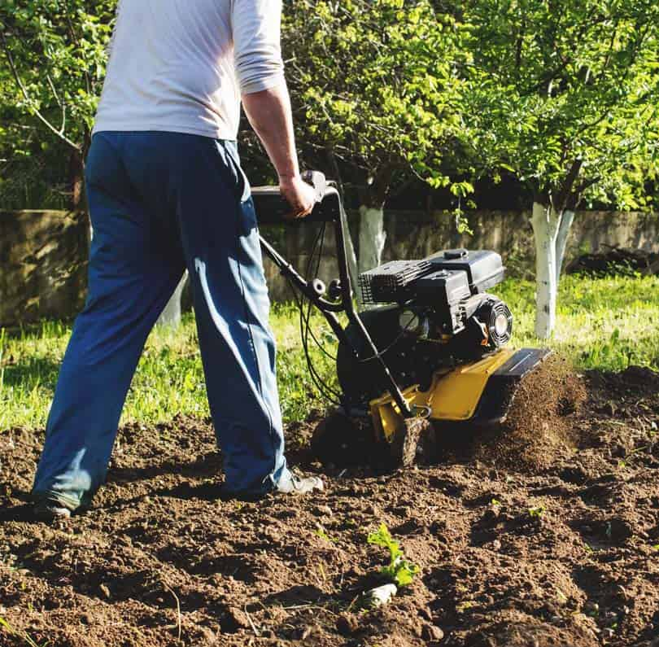
Section 4- (87-124) Exemptions
§ 87-124 (3) An excavation or demolition that involves the tilling of soil for agricultural or gardening purposes that encroaches on any operator's right-of-way, easement, or permitted use and is less than 12 inches in depth.
§ 87-124 (5) An excavation by an operator, surveyor, or their contractor with nonmechanized equipment for
Locating for a valid notification request or for the minor repair, connection or routine maintenance of an existing facility or survey pin.
Probing underground to determine the extent of gas or water migration.
Bold Print References Law addition
Notes:
Exemptions.
An excavation or demolition that involves the tilling of soil for agricultural or gardening purposes that encroaches on any operator's right-of-way, easement, or permitted use and is less than 12 inches in depth.
An excavation by an operator, surveyor, or their contractor with nonmechanized equipment for Locating for a valid notification request or for the minor repair, connection or routine maintenance of an existing facility or survey pin.
Or Probing underground to determine the extent of gas or water migration.

Slide 14
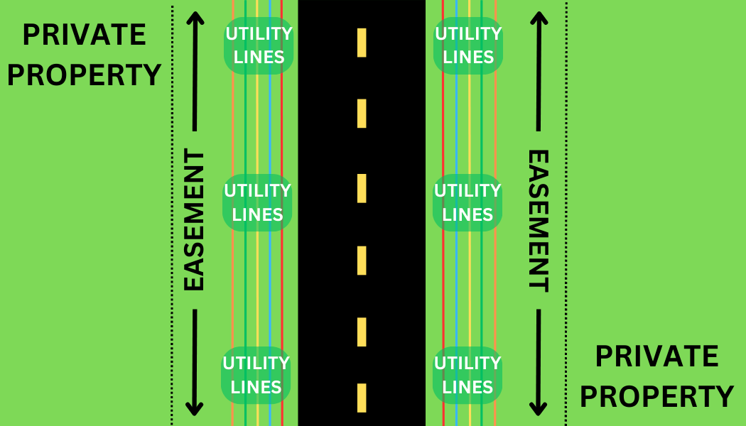
Section 4- (87-124) Exemptions
§ 87-124 (6) An excavation or demolition performed for the purpose of maintenance activities within the right-of-.way.
§ 87-124 (6) The provisions of this subdivision do not apply when the excavation or demolition is performed by a contractor acting on behalf of a person or entity responsible for routine maintenance of a right-of-way.
Bold Print References Law addition
Notes:
An excavation or demolition performed for the purpose of maintenance activities within the right-of-.way.
The provisions of this subdivision do not apply when the excavation or demolition is performed by a contractor acting on behalf of a person or entity responsible for routine maintenance of a right-of-way.

Slide 15
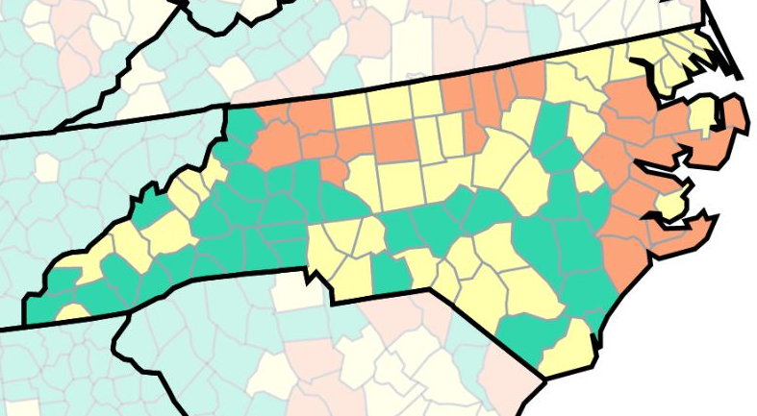
Section 5- (87-126) Notification required when damage is done
§ 87-126 (c) The venue for claims adjudication for actual and consequential damages occurring in North Carolina shall be held within North Carolina court system in the county of the occurrence.
Bold Print References Law addition
Notes:
Damage Claims
Claims must now be adjudicated in North Carolina, in the county where the incident occurred.
If an operator fails to respond or improperly locates a facility, the excavator may proceed—provided due care is exercised.
Excavators are presumed to have exercised due care unless proven otherwise.

Slide 16

Section 6 – (87-128) Absence of facility location
§ 87-128 If an operator who has been given notice as provided by GS 87-120(d) by the Notification Center fails to respond to a notice as provided by GS 87-121 or fails to properly locate the facility, the person excavating is free to proceed with excavation and neither the excavator nor the person financially responsible for the excavation will be liable to the nonresponding or improperly responding operator for damages to the operator’s facilities, so long as the excavator has exercised due care in preparing for or conducting the excavation. For the purposes of this section, the excavator shall be entitled to a presumption, rebuttable by clear and convincing evidence, that it has exercised due care in preparing for and conducting the excavation where
(i) the Notification Center gives the operator the notice required by GS 87-120(d)
(ii) the operator fails to respond to that notice as provided in GS 87-121 or fails to properly locate the facility,
(iii) the excavator has complied with the requirements of GS 87-122(c), and
(iv) the excavator did not have actual knowledge of the existence of a facility located within the area of the excavation to be performed.
Bold Print References Law addition
Notes:
In section 87-128 additional language has been added: so long as the excavator has exercised due care in preparing for or conducting the excavation. For the purposes of this section, the excavator shall be entitled to a presumption (the law assumes something in favor of the excavator), rebuttable by clear and convincing evidence, that it has exercised due care in preparing for and conducting the excavation. Therefor the Excavator must comply with the 87-122 © - Excavator responsibilities section.
Notification Center gives the operator the notice
The operator fails to respond to that notice as provided in GS 87-121 or fails to properly locate the facility.
The excavator has complied with the requirements of GS 87-122.
The excavator did not have actual knowledge of the existence of a facility located within the area of the excavation to be performed.

Slide 17

Section 7 – (87-129) Underground Damage Prevention Review Board; enforcement; civil penalties
§ 87-129 (a1) Requires the Governor to fill vacancies within 60 days after the vacancy, to the extent practicable.
§ 87-129 (a4) A quorum is met when a majority of the seated members of the Board, rather than eight members, and allows members to attend meetings via conference call or other electronic means.
Bold Print References Law addition
Notes:
Changes to the Underground Damage Prevention Review Board
New addition requiring the Governor to fill Board vacancies within 60 days. No time requirement in the current law.
Quorum will be met with majority seated and allows members to attend meetings via conference call or other electronic means. (TEAMS meeting)

Slide 18

Section 7 – (87-129) Underground Damage Prevention Review Board; enforcement; civil penalties
§ 87-129 (a7) The Board shall establish an internal attendance policy. In the event a Board member resigns or fails to meet the criteria of the attendance policy, the Board may appoint an interim member to represent the same stakeholder group until such time the Governor appoints a replacement for the remainder of the unexpired term.
§ 87-129 (a8) On request of the Board, the Utilities Commission shall appoint a nonvoting ex officio member as an administrative representative to provide counsel and coordinate efforts of the board.
Bold Print References Law addition
Notes:
The Board shall establish an internal attendance policy. In the event a Board member resigns or fails to meet the criteria of the attendance policy, the Board may appoint an interim member to represent the same stakeholder group until such time the Governor appoints a replacement for the remainder of the unexpired term.
On request of the Board, the Utilities Commission shall appoint a nonvoting ex officio member as an administrative representative to provide counsel and coordinate efforts of the board.

Slide 19

Section 7 - (87-129) Underground Damage Prevention Review Board; enforcement; civil penalties
§ 87-129 (b) The Board shall receive reports of alleged violations and shall contact persons against whom reports have been filed from 10 days to 15 working days.
§ 87-129 (b1) The Board shall notify within 30 days each person who is determined to have violated the Article in writing of the Board's determination and the Board's recommended action or penalty.
Bold Print References Law addition
Notes:
The Board will now have 15 working days to contact persons of the alleged violation, extended from 10 days.
The Board will be required to notify the violator of the boards determination within 30 days. There was no time period in the current law,

Slide 20

Section 7 - (87-129) Underground Damage Prevention Review Board; enforcement; civil penalties
§ 87-129 (b2) A person deemed to be in violation could request an informal conference before the Board within 30 days of the determination. Such a person must attend the informal conference in person. The person may be represented by an attorney or other person and present evidence and make arguments in favor of the person's position. Following the informal conference, the Board may reverse, modify, or uphold its original findings. If the Board recommends a penalty, the Board shall notify the Utilities Commission, and the Commission must issue an order imposing the penalty within 30 days.
Bold Print References Law addition
Notes:
After the boards determination, the person deemed to be in violation can request an informal conference within 30 days of the determination. They must attend in person, can be represented by an attorney or other person and present evidence and make arguments in favor of the person's position.

Slide 21
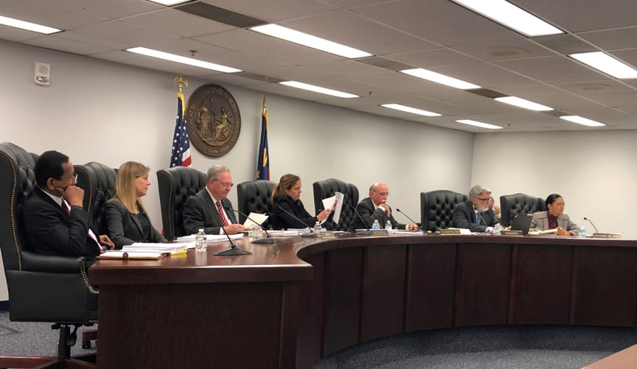
Section 7 - (87-129) Underground Damage Prevention Review Board; enforcement; civil penalties
§ 87-129 (d1) The Utilities Commission shall annually report to the Board compliance of persons on whom fines or penalties have been imposed.
§ 87-129 (d2) If the penalty is not paid to the Utilities Commission within 90 days of issuance, the Attorney General, at the request of the Utilities Commission, shall bring an action in the name of the State of NC in the Superior Court for Wake County to recover the penalty.
Bold Print References Law addition
Notes:
Utilities Commission will be required to report annually a report of fine or penalties imposed.
If the penalty is not paid, the Utilities Commission can request Attorney General bring action in the name of the State of NC to recover the penalty.

Slide 22
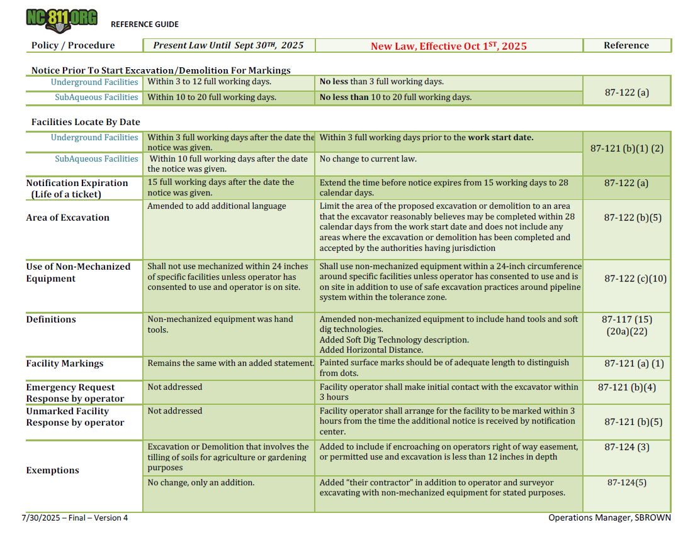
Notes:
Finally, a reference guide is available at local UCC meetings and online. It includes:
A side-by-side comparison of current vs. new law
And statute references for easy lookup

Slide 23
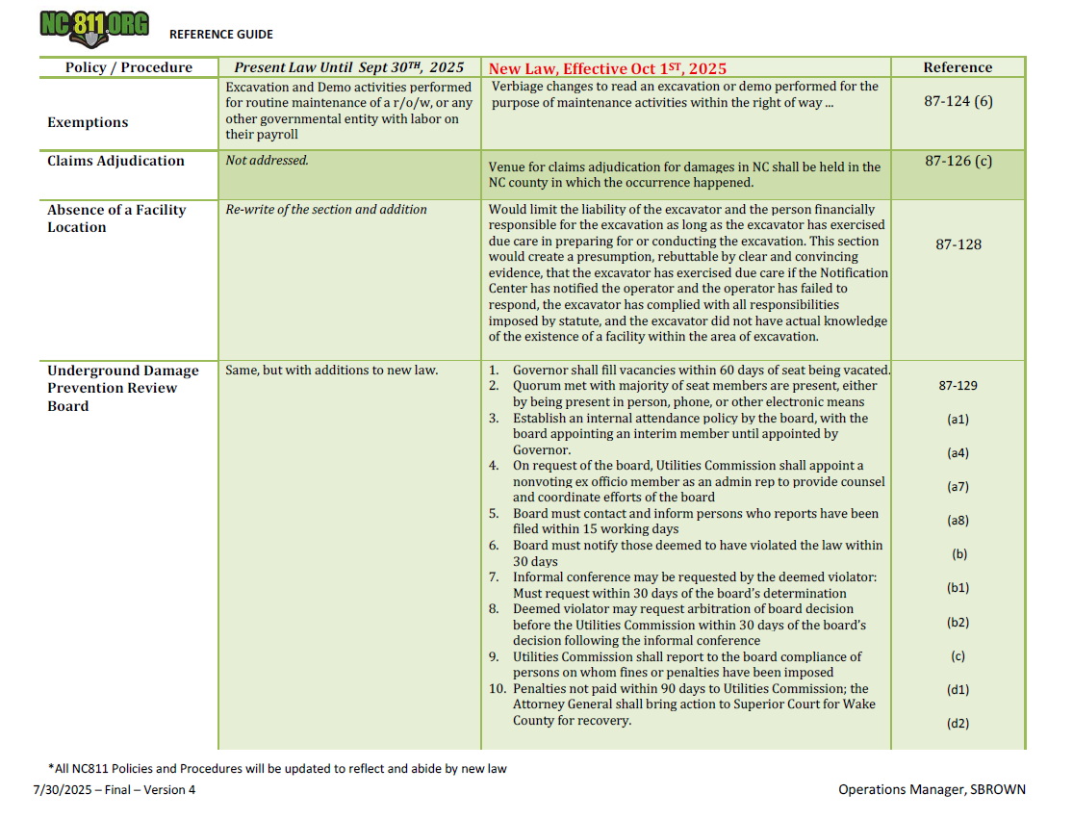

Slide 24

EFFECTIVE DATE: This act becomes effective October 1, 2025.
Notes:
Thank you for your attention.
You’ll find a QR code on your screen that links directly to the law page on nc811.org.
There you can download the law reference guide comparing the old and new provisions.
There is also a full-length video of this presentation that you can watch at your leisure.
And if you have any questions about any part of the law you can fill out the Law FAQ form and one of our liaisons will provide you with clarification on any of your concerns.
Let’s continue working together to ensure safe and c ompliant excavation practices.

