Slide 1

HOUSE BILL 247: Underground Utility Safety and Damage Prevention Act Revisions.
2025-2026 General Assembly

Slide 2

OVERVIEW: House Bill 247 would do all of the following with regard to marking of underground utilities:
Specify that nonmechanized equipment includes soft dig technologies.
Clarify the standards of painted surface marks for operators marking underground facilities and adjust response times for requests for marking of a facility.
Shorten the notice period for projects not involving subaqueous facilities, extend notice validity, limit the area for facility location requests, and clarify excavation practices near pipelines.
Amend exemptions from requirements for notice before commencing an excavation.
Clarify that the venue for all actions arising from actual and consequential damages occurring in this State is the county where the damages occurred.
Create a rebuttable presumption that an excavator has exercised due care in certain circumstances.
Make changes to the Underground Damage Prevention Review Board (Board) concerning vacancies and quorum and allow an informal conference process to request that the Board reverse or modify its determinations concerning violations of the Act.

Slide 3

CURRENT LAW AND BILL ANALYSIS:

Slide 4
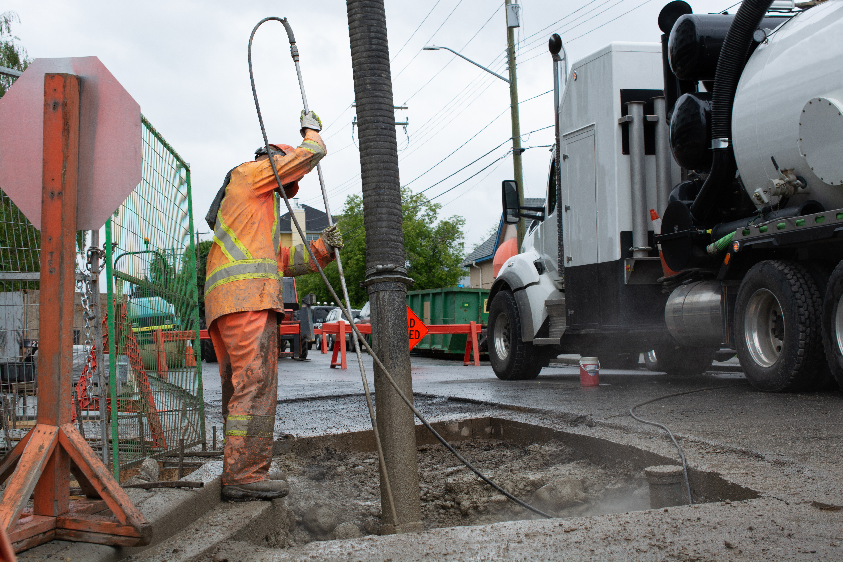
Section 1 – (87-117) Definitions
87-117 (15) – Nonmechanized equipment – Hand tools and soft dig technologies.
87-117 (20a)“Soft dig technologies“- An excavation method that uses air or water pressure to break up soil and remove it with vacuum extraction.
87-117 (22) – Tolerance zone – If the diameter of the facility is known, the horizontal distance of one-half of the known diameter plus 24 inches on either side

Slide 5
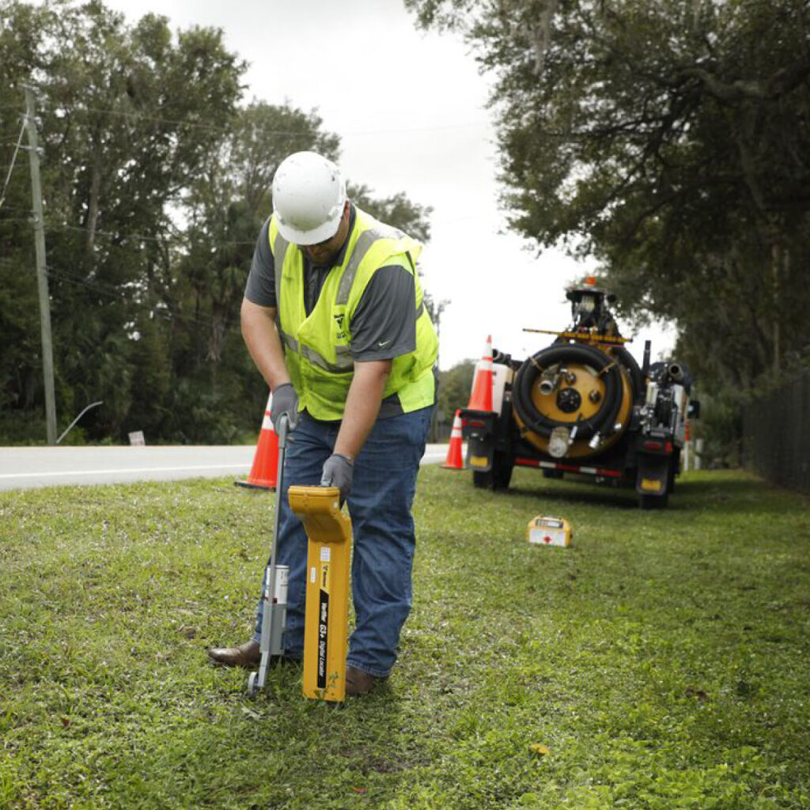
Section 2 – (87-121) Facility operator responsibilities
87-121 (a)(1) Specifies when a facility operator marks facilities, where practical, the painted surface marks must be long enough to distinguish them from dots.
87-121 (b) This section would also modify an operator's duties when information is requested by an excavator as follows, unless otherwise provided in a written agreement between the operator and the excavator, including an electronically transmitted written agreement

Slide 6
Section 2 – (87-121) Facility operator responsibilities
87-121 (b)(1)For a facility, the operator must provide the information within three full working days prior to the work start date provided by the excavator. Under current law, the operator must provide the information within three working days after the day that the excavator provided notice of the proposed excavation or demolition to the Notification Center.
87-121 (b)(4) For an emergency request, an initial contact with the excavator shall be made within 3 hours.
87-121 (b) (5)For a request of an unmarked facility because the operator has failed to respond to the positive response system or excavator sees evidence of a facility, the operator shall arrange for the facility to be marked within three hours from the time the additional notice is received by the Notification Center.

Slide 7

Section 3 – (87-122) Excavator responsibilities
87-122 (a) Require that notice for any excavation or demolition not involving a subaqueous facility must be given not less than three full working days before the proposed commencement date of the excavation or demolition. Under current law, notice must be provided between three to twelve full working days before the proposed commencement date.
87-122 (a) Require that notice for any excavation or demolition in the vicinity of a subaqueous facility be given no less than 10 to 20 full working days before the proposed commencement date of the excavation or demolition. Under current law, notice must be provided within 10 to 20 full working days before the proposed commencement date.

Slide 8
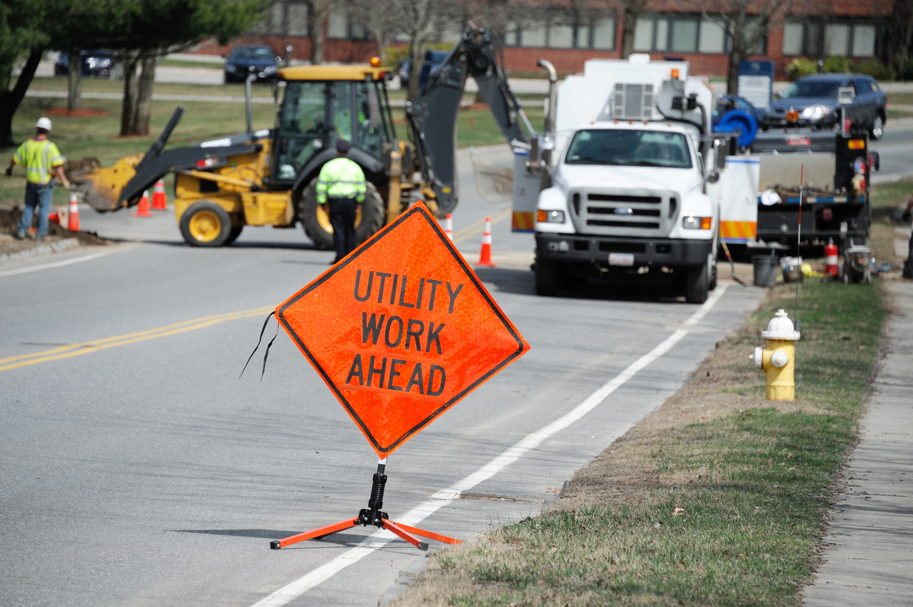
Section 3 – (87-122) Excavator responsibilities
87-122 (a) Extend the time before notice expires from 15 working days to 28 calendar days.
87-122 (b)(5) The area of locate of the proposed excavation which is limited to an area that the excavator reasonably believes may be completed within 28 calendar days from the work start date and does not include any areas completed and accepted by the authorities having jurisdiction.
87-122 (c)(10) Clarify requirements regarding the use of nonmechanized equipment within a 24-inch circumference around an oil or gas pipeline. The section would specify that safe excavation practices, including, but not limited to, hand digging or potholing, must be used within the tolerance zone of a pipeline.
87-122 (c)(10) Within the tolerance zone of a pipeline system, the excavator shall use safe excavation practices, including, but not limited to hand digging or potholing.

Slide 9
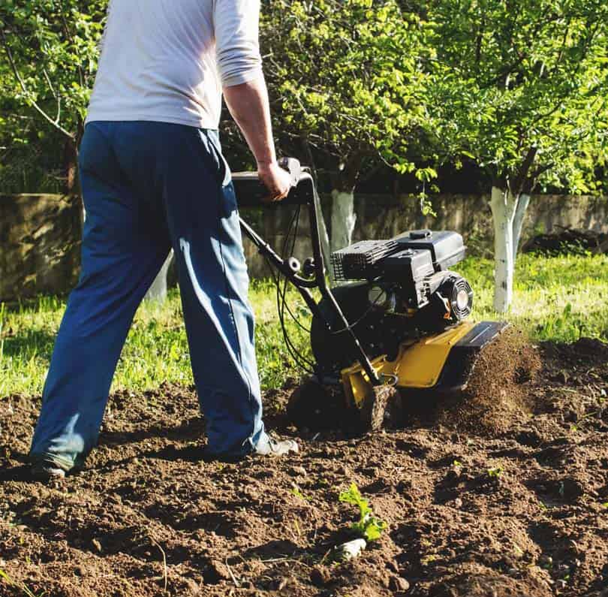
Section 4- (87-124) Exemptions
87-124 (3) An excavation or demolition that involves the tilling of soil for agricultural or gardening purposes that encroaches on any operator's right-of-way, easement, or permitted use and is less than 12 inches in depth.
87-124 (5) An excavation by an operator, surveyor, or their contractor with nonmechanized equipment for locating for the minor repair, connection or routine maintenance of an existing facility or survey pin. Also, probing underground to determine the extent of gas or water migration are exempt.

Slide 10
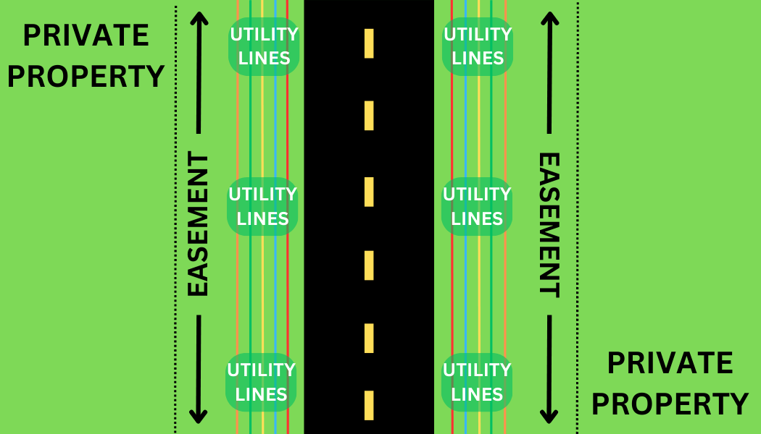
Section 4- (87-124) Exemptions
87-124 (6) Under current law, excavations or demolitions performed when a person responsible for routine maintenance of a right-of-way or any other governmental entity performs maintenance activities within the right-of-way using labor on their permanent payroll. An excavation or demolition performed for the purpose of maintenance activities within the right-of-.way.
87-124 (6) The provisions of this subdivision do not apply when the excavation or demolition is performed by a contractor acting on behalf of a person or entity responsible for routine maintenance of a right-of-way.

Slide 11
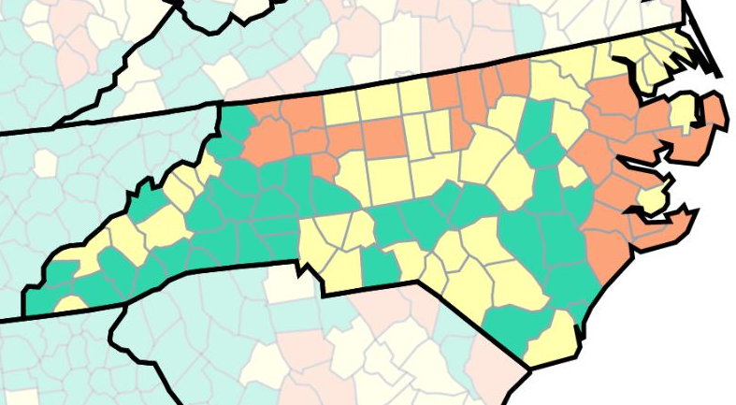
Section 5- (87-126) Notification required when damage is done
87-126 (c) The venue for claims adjudication for actual and consequential damages occurring in North Carolina shall be held within North Carolina court system in the county of the occurrence.

Slide 12

Section 6 – (87-128) Absence of facility location
87-128 If an operator fails to respond to a notice or fails to properly locate the facility, the person excavating is free to proceed with excavation and neither the excavator nor the person financially responsible for the excavation will be liable to the nonresponding or improperly responding operator for damages to the operator’s facilities, so long as the excavator has exercised due care in preparing for or conducting the excavation. For the purposes of this section, the excavator shall be entitled to a presumption, rebuttable by clear and convincing evidence, that it has exercised due care in preparing and conducting the excavation, the operator fails to respond to that notice or fails to properly locate the facility, the excavator has complied with the requirements and the excavator did not have actual knowledge of the existence of a facility located within the area of the excavation to be performed.

Slide 13

Section 7 – (87-129)
Underground Damage Prevention Review Board; enforcement; civil penalties
87-129 (a1) Requires the Governor to fill vacancies within 60 days after the vacancy, to the extent practicable.
87-129 (a4) A quorum is met when a majority of the seated members of the Board, rather than eight members, and allows members to attend meetings via conference call or other electronic means.

Slide 14

Section 7 – (87-129)
Underground Damage Prevention Review Board; enforcement; civil penalties
87-129 (a7) The Board shall establish an internal attendance policy. In the event a Board member resigns or fails to meet the criteria of the attendance policy, the Board may appoint an interim member to represent the same stakeholder group until such time the Governor appoints a replacement for the remainder of the unexpired term.
87-129 (a8) On request of the Board, the Utilities Commission shall appoint a nonvoting ex officio member as an administrative representative to provide counsel and coordinate efforts of the board.

Slide 15

Section 7 - (87-129)
Underground Damage Prevention Review Board; enforcement; civil penalties
87-129 (b) The Board shall receive reports of alleged violations and shall contact persons against whom reports have been filed from 10 days to 15 working days.
87-129 (b1) The Board shall notify within 30 days each person who is determined to have violated the Article in writing of the Board's determination and the Board's recommended action or penalty.

Slide 16

Section 7 - (87-129)
Underground Damage Prevention Review Board; enforcement; civil penalties
87-129 (b2) A person deemed to be in violation could request an informal conference before the Board within 30 days of the determination. Such a person must attend the informal conference in person. The person may be represented by an attorney or other person and present evidence and make arguments in favor of the person's position. Following the informal conference, the Board may reverse, modify, or uphold its original findings. If the Board recommends a penalty, the Board shall notify the Utilities Commission, and the Commission must issue an order imposing the penalty within 30 days.

Slide 17
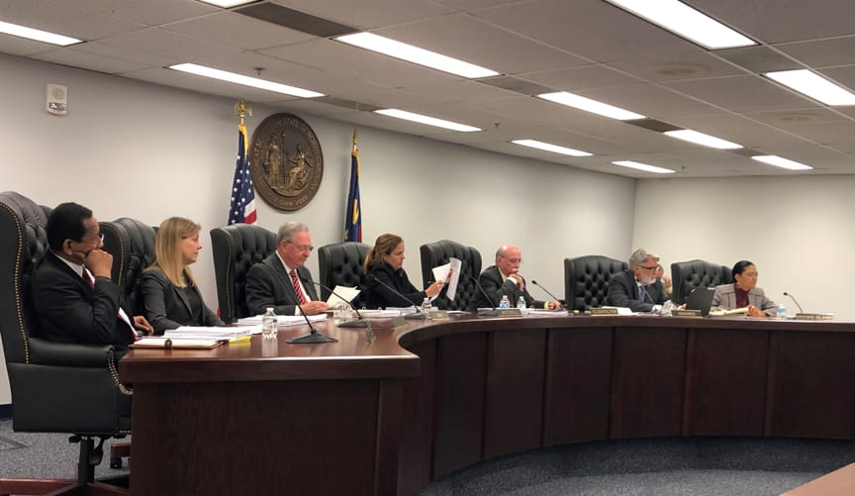
Section 7 - (87-129)
Underground Damage Prevention Review Board; enforcement; civil penalties
87-129 (d1) The Utilities Commission shall annually report to the Board compliance of persons on whom fines or penalties have been imposed.
87-129 (d2) If the penalty is not paid to the Utilities Commission within 90 days of issuance, the Attorney General, at the request of the Utilities Commission, shall bring an action in the name of the State of NC in the Superior Court for Wake County to recover the penalty.

Slide 18
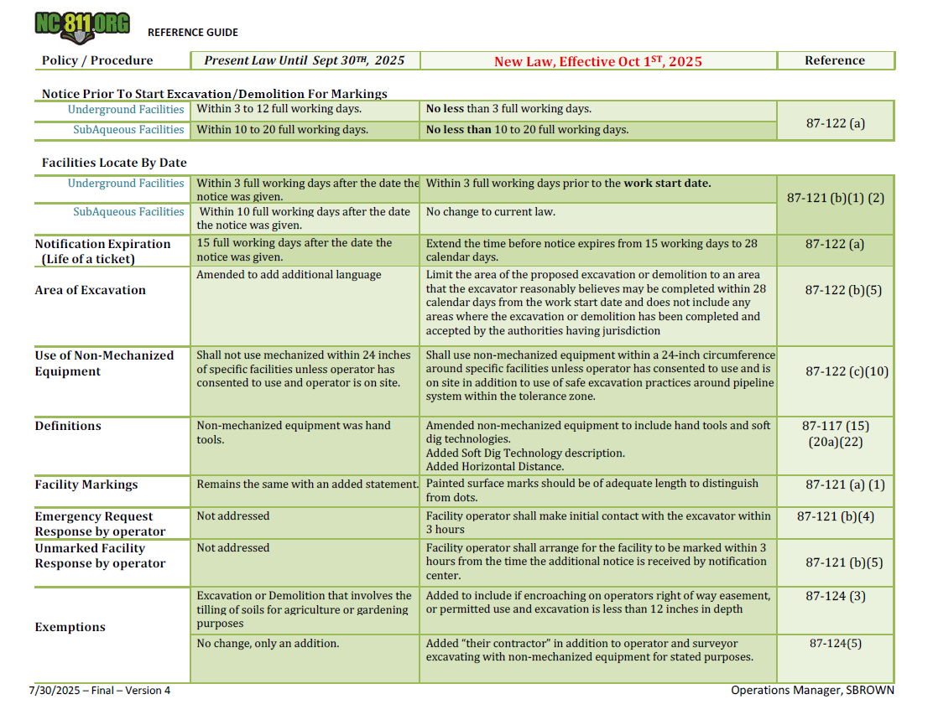

Slide 19
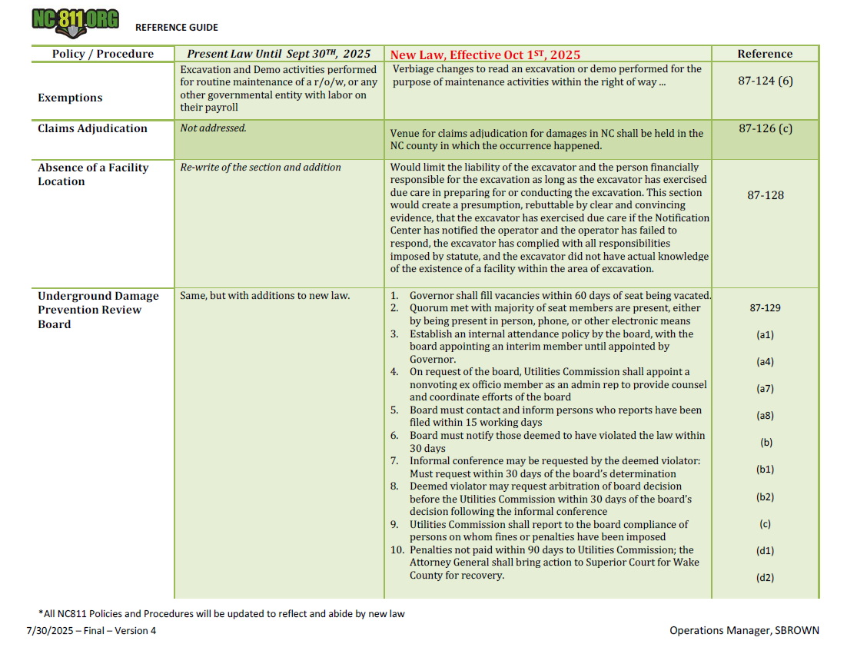

Slide 20

EFFECTIVE DATE: This act becomes effective October 1, 2025.

